Slide 1
Abaqus Python
Abaqus Python Scripting
Learn with the concepts
Lec 4 – Abaqus Data Types

Slide 2
Content:
Abaqus python scripting guide
Abaqus Scripting Interface data types
SymbolicConstants
Boolean
Repositories
Importing modules

Slide 3
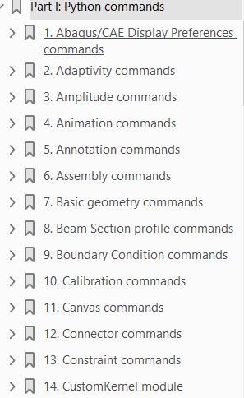
Abaqus python scripting guide
Chapters are grouped alphabetically by functionality.
Within each chapter the primary objects appear first and are followed by other objects in alphabetical order.
Mesh commands
Assembly
Part
ElemType
MeshEdge
MeshElement
MeshFace
MeshNode
MeshStats
Within each object description, the commands are listed in the following order:
Constructors
Methods
Members

Slide 4
Abaqus python scripting guide
The description of each object is organised as follows:
Odb object
description
Access
import odbAccess
session.odbs[name]
Odb(...)
description
Path
session.Odb
close()
getFrame(...)
save()
update()
Members
Members descriptions
Object name and description details
Module to be imported to use this object
How to access attributes/members and methods
Constructors available for the object
Path is specified only for the constructor
Methods available for the object
Members available for the object

Slide 5

Abaqus python scripting guide
Different types of arguments:
Methods
Odb(...)
close()
getFrame(...)
save()
update()
Methods require arguments
Examples:
Odb(...)
getFrame(...)
Methods DOES NOT require arguments
Examples:
close()
save()
update()
Required arguments
Optional arguments
Must be provided.
If omitted, default value is set.
All the required and optional arguments can be given as positional or keyword arguments.
Positional Arguments
Keyword Arguments
newViewport = session.Viewport(
'myViewport',(10, 10), 100, 50)
newViewport = session.Viewport(name=
'myViewport',origin=(10, 10), width=100,height=50)
NOT recommended
Recommended

Slide 6
Abaqus python scripting guide
Return value from the methods:
All methods return a value.
Many commands return the None object.
Constructor return object being created.
from odbAccess import *
odb = openOdb(path=‘beam_model.odb’)
if odb.isReadOnly:
print(‘The results data will not be written to the ODB file, as it is in Read ONLY mode’)

Slide 7
Abaqus Scripting Interface data types
The Abaqus Scripting Interface adds over 500 additional data types.
SymbolicConstants
Some Abaqus defined constants.
To use these constants, we must import
from abaqusConstants import *
Example: Part dimensionality
THREE_D, TWO_D_PLANAR, AXISYMMETRIC

Slide 8
Abaqus Scripting Interface data types
Booleans
Python boolean
True
False
Derived from AbaqusConstants.
from abaqusConstants import *
Abaqus boolean
ON
OFF

Slide 9
Abaqus Scripting Interface data types
Repositories
Used to store the similar type of object.
Field output
Frame
Step
key
index
key
odb.steps[‘Step-1’]
odb.steps[‘Step-1’].frames[1]
odb.steps[‘Step-1’].frames[1].fieldOutputs[‘U’]
You can change the name of object in repositories.
mdb.models['Model-1'].parts.changeKey(fromName='housing',toName='form')

Slide 10
Importing modules
You can reuse already written code by importing it as a module.
Commonly used importing styles are:
Namespace
System that has a unique name for each and every object in python
import funs
Bring in objects from module funs.py via a namespace funs
Bring in object “square” from module funs.py into the current namespace
from funs import square
from funs import *
bring in all objects from module funs.py into current namespace

